Slide 1



Introduction to Linux Architecture
Linux is a free and open-source operating system known for its flexibility and stability. Its architecture is comprised of various layers that work together to manage resources and provide a user-friendly interface.

Slide 2
Kernel Architecture
The Linux kernel is the core of the operating system, responsible for managing the hardware and providing basic services. It's a complex piece of software, containing modules for memory management, process scheduling, and file system access.
Kernel Modules
System Calls
Kernel Space
The kernel is built as a modular system, allowing for features to be added or removed dynamically.
User programs interact with the kernel through system calls, which are carefully defined interfaces to the kernel's functionality.
The kernel runs in a protected space known as kernel space, separate from user applications.

Slide 3

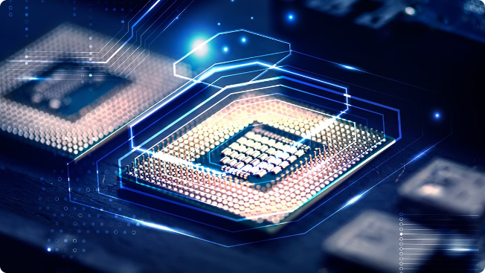
Process Management
Process management in Linux involves creating, scheduling, and terminating processes. It ensures that multiple programs can run concurrently, sharing the system's resources effectively.
1
Process States
2
Process Scheduling
Processes transition between various states like running, ready, waiting, and terminated. The kernel manages these transitions based on resource availability and system load.
Linux employs advanced scheduling algorithms to allocate CPU time fairly among running processes, optimizing performance.
3
Process Communication
Processes can communicate with each other using mechanisms like pipes, shared memory, and message queues.

Slide 4


Memory Management
Memory management is crucial for allocating and reclaiming memory for running processes. It aims to prevent memory leaks and ensure efficient use of available resources.
Virtual Memory
Provides a larger address space for processes than physical memory.
Paging
Divides memory into fixed-size units called pages, allowing for efficient memory allocation and swapping.
Memory Allocation
Kernel manages how processes request and receive memory, ensuring that no conflicts occur.

Slide 5

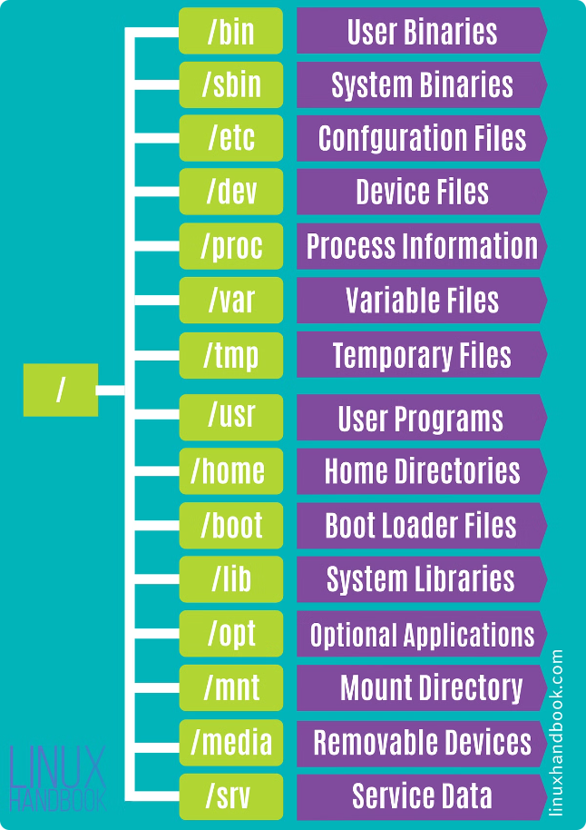
File System
The file system organizes and manages files and directories on disk, allowing for efficient storage and retrieval of data. It also provides a hierarchical structure that makes navigating files easy.
Ext4
XFS
A widely used journaling file system that provides fast performance and data integrity.
A high-performance file system that's commonly used for large file systems and databases.
Btrfs
A modern file system that offers features like snapshots, data deduplication, and copy-on-write.

Slide 6

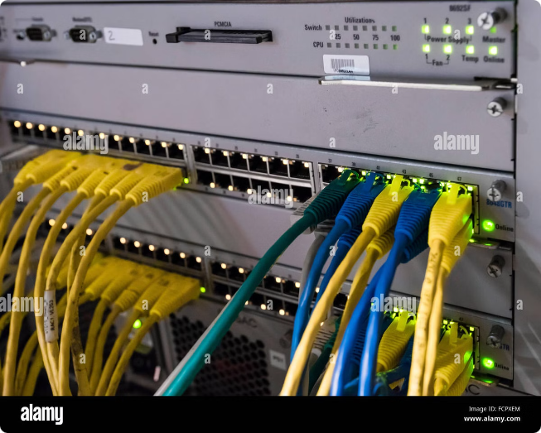



Networking
Linux offers a powerful and versatile network stack that supports various protocols and network interfaces. It's crucial for communication between computers and access to online resources.
Network Interface Cards
Physical hardware components that allow computers to connect to a network.
Network Protocols
Standard rules and procedures that govern communication between devices on a network.
Network Services
Software applications that provide specific network functionalities, such as web servers and mail servers.

Slide 7





Security
Linux is renowned for its robust security features, including user management, access control, and firewalls. It protects the system from unauthorized access and malicious threats.
Firewalls
User Permissions
Security Updates
Filter network traffic based on predefined rules, preventing unauthorized access and malicious attacks.
Control access to files and resources based on user identity and assigned permissions.
Regular updates patch vulnerabilities and security holes, protecting the system from new threats.

Slide 8


Conclusion
The Linux architecture is a testament to its design principles of flexibility, stability, and security. It's a powerful and versatile platform, suitable for a wide range of applications and environments.

